Slide 1
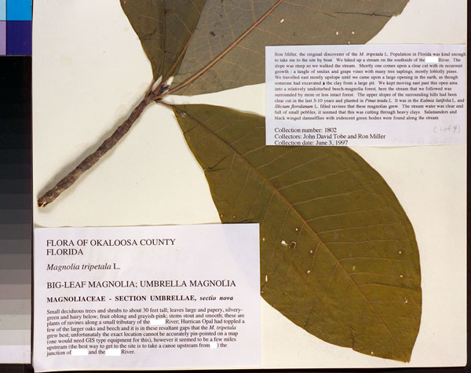
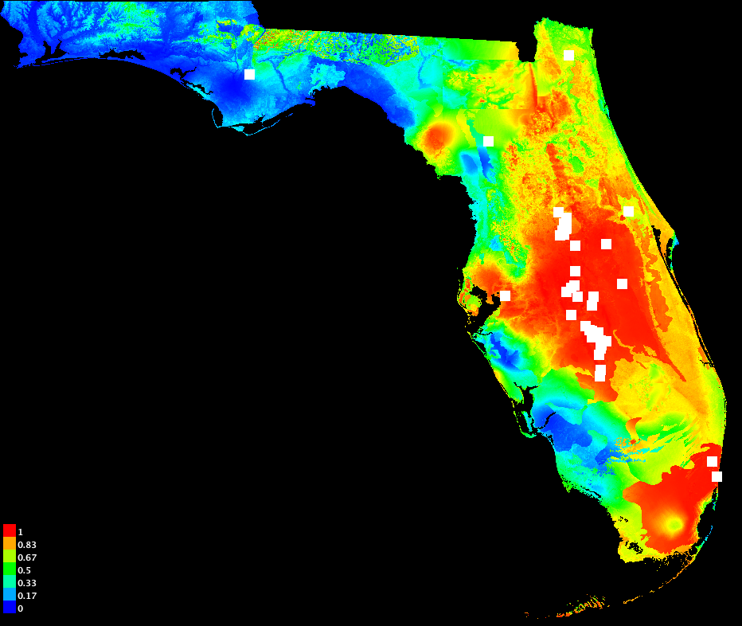
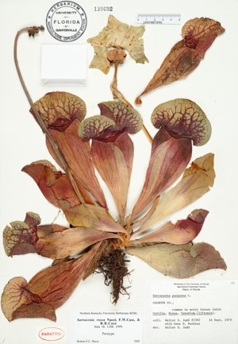
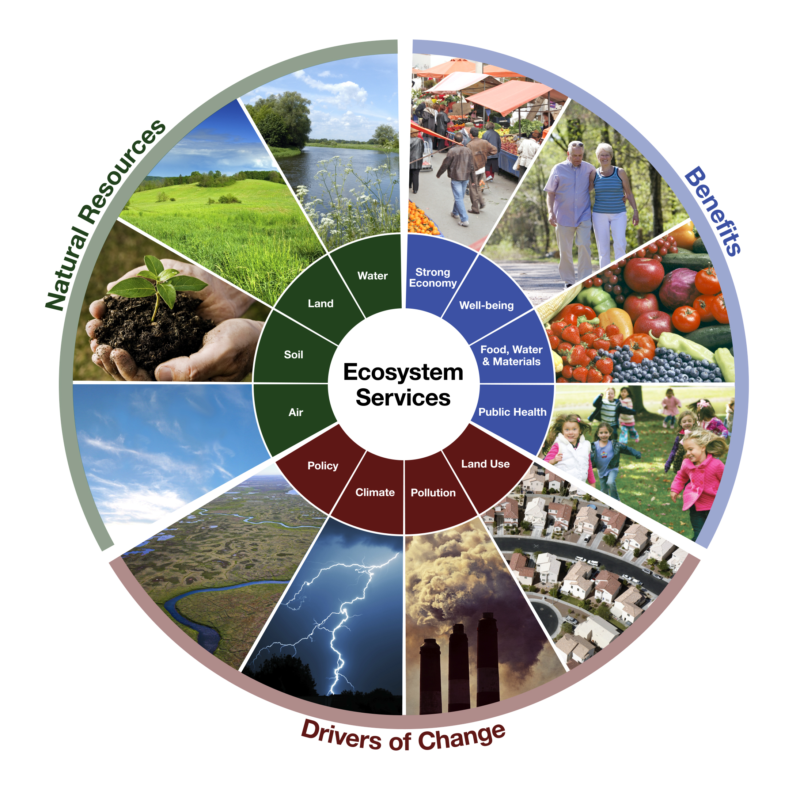
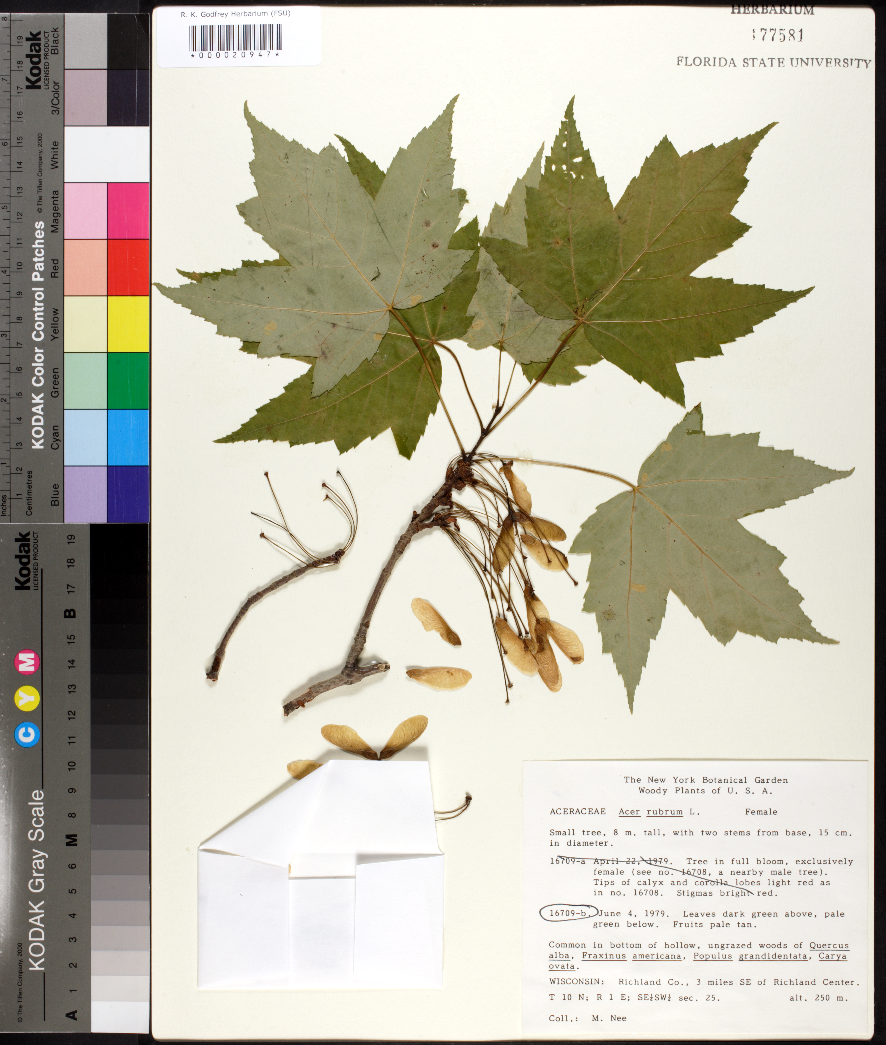
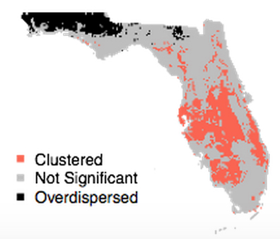
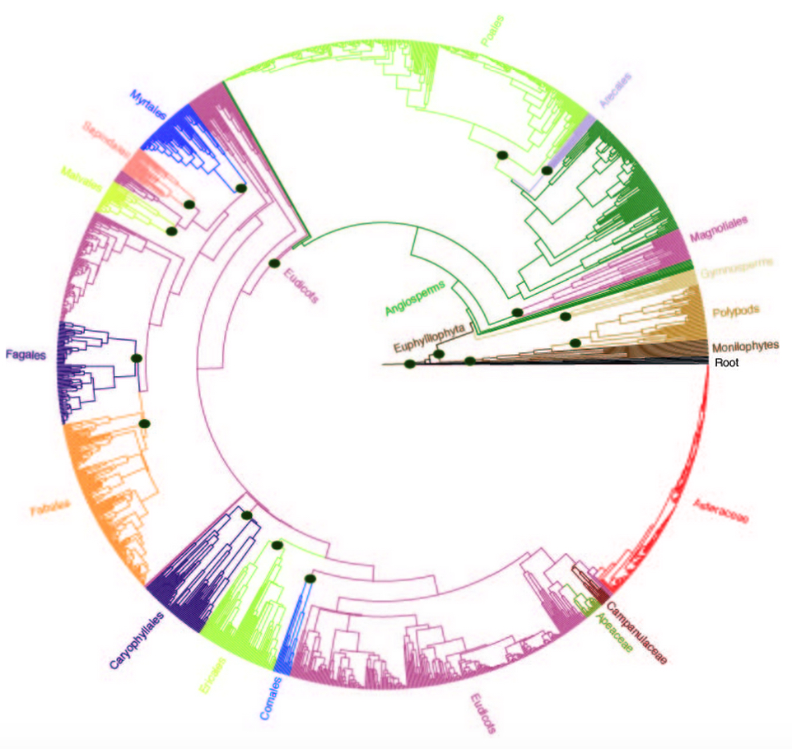


Applications of Ecological Niche Modeling
Pamela S. Soltis
University of Florida
Notes:
Thanks to a new program at NSF, more and more US collections are going online. UF is now home to iDigBio, the national center for digitization of biodiversity collections, which has the mission of coordinating digitization and databasing of US collections. iDigBio ingests, serves, and integrates data, such as locality information, date of collection, and images, from all natural history collections in the country.

Slide 2
Applications of Ecological Niche Models
Estimate current distribution
Predict future distributions
Infer past distributions
Use as foundation for phylogenetic diversity studies
Niche of polyploid compared to its diploid progenitor(s)

Slide 3
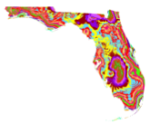
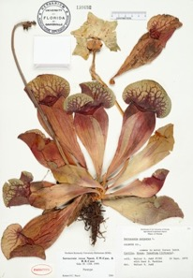


Florida Plant Diversity in a Changing Climate: Present & Future
Julie Allen, Charlotte Germain-Aubrey,
K. Neubig, L. Majure, R. Abbott, M. Whitten, N. Barve, H. Owens,
B. Mishler, S. Laffan, R. Guralnick, D. Soltis
Rob Guralnick
Allen, Germain-Aubrey et al. 2019, unpubl.
Julie Allen

Slide 4
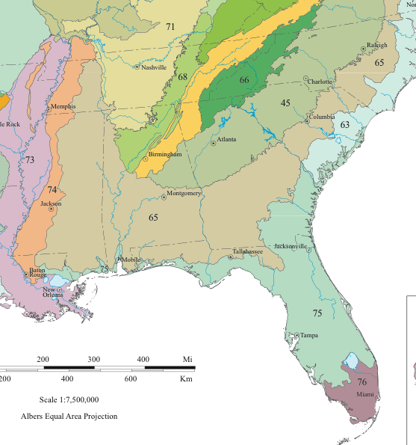
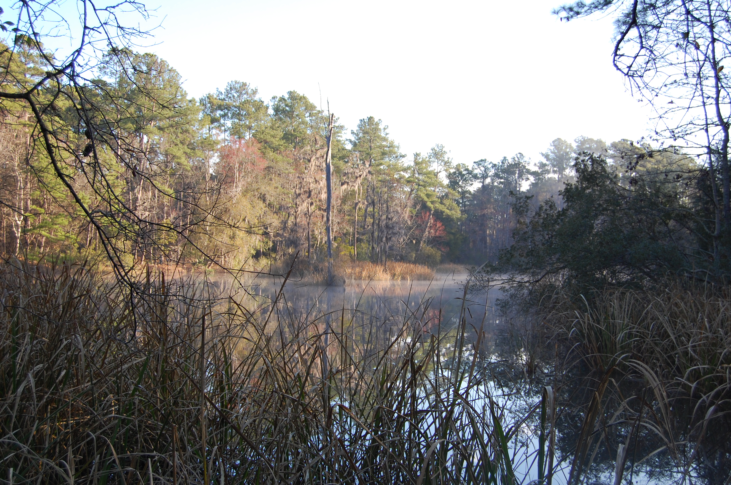
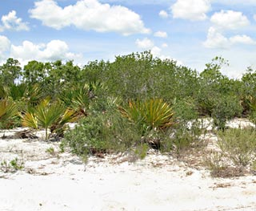
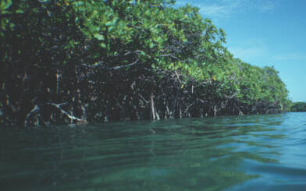
Florida Ecoregions
Southeastern Plain
Southern Coastal Plain
Southern Florida Coastal Plain
~4,100 vascular plant species
Notes:
GEOLOGY, PHYSIOGRAPHY, VEGETATION, CLIMATE, SOILS, LAND USE, WILDLIFE, HYDROLOGY

Slide 5
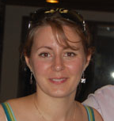
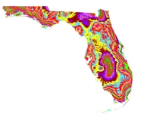
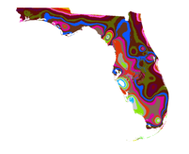
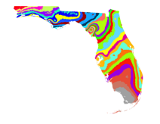
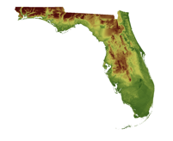
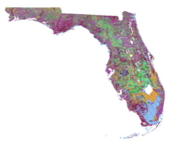
Modeling the Distribution of Species
Location information from herbarium labels
Environmental data:
Temperature, precipitation, soil, etc.
Software to model the range of each species
For Florida plants:
~1500 plant species (of 4100 species)
Charlotte
Germain-Aubrey
Notes:
We used specimen data from the herbaria of UF, FSU, and U of S Florida (>500,000 specimens) to map the distribution of >2700 species. We then used software for ecological niche modeling of each species based on environmental features, such as temperature, precipitation, soil type, etc.

Slide 6
Modeling the Distribution of Species: Present
Notes:
We used specimen data from the herbaria of UF, FSU, and U of S Florida (>500,000 specimens) to map the distribution of >2700 species. We then used software for ecological niche modeling of each species based on environmental features, such as temperature, precipitation, soil type, etc.

Slide 7
Modeling the Distribution of Species: Present
Notes:
We used specimen data from the herbaria of UF, FSU, and U of S Florida (>500,000 specimens) to map the distribution of >2700 species. We then used software for ecological niche modeling of each species based on environmental features, such as temperature, precipitation, soil type, etc.

Slide 8
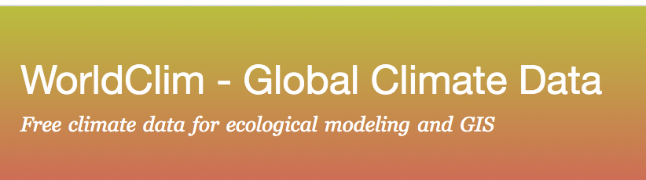
Modeling the Distribution of Species: Present
Notes:
We used specimen data from the herbaria of UF, FSU, and U of S Florida (>500,000 specimens) to map the distribution of >2700 species. We then used software for ecological niche modeling of each species based on environmental features, such as temperature, precipitation, soil type, etc.

Slide 9
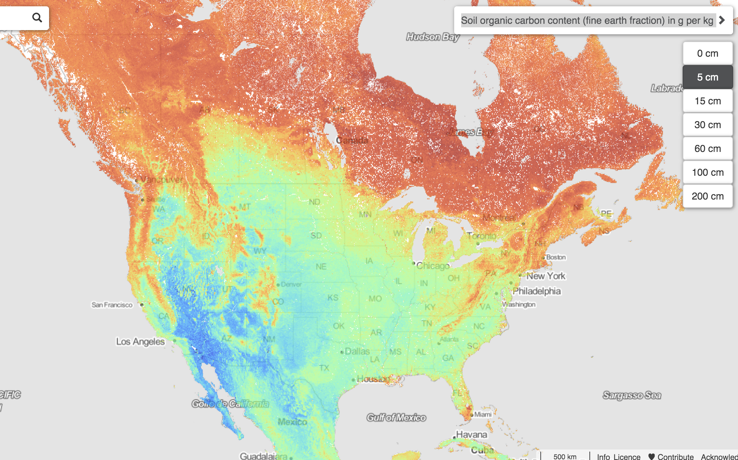
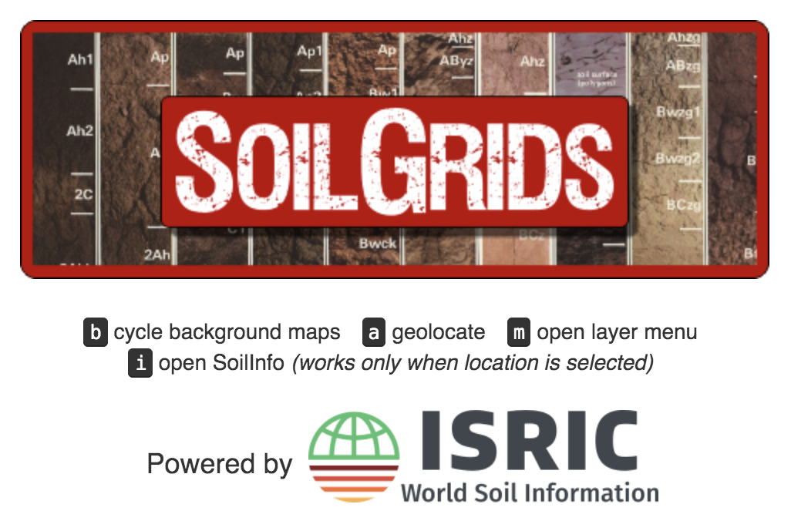
Modeling the Distribution of Species: Present
Notes:
We used specimen data from the herbaria of UF, FSU, and U of S Florida (>500,000 specimens) to map the distribution of >2700 species. We then used software for ecological niche modeling of each species based on environmental features, such as temperature, precipitation, soil type, etc.

Slide 10
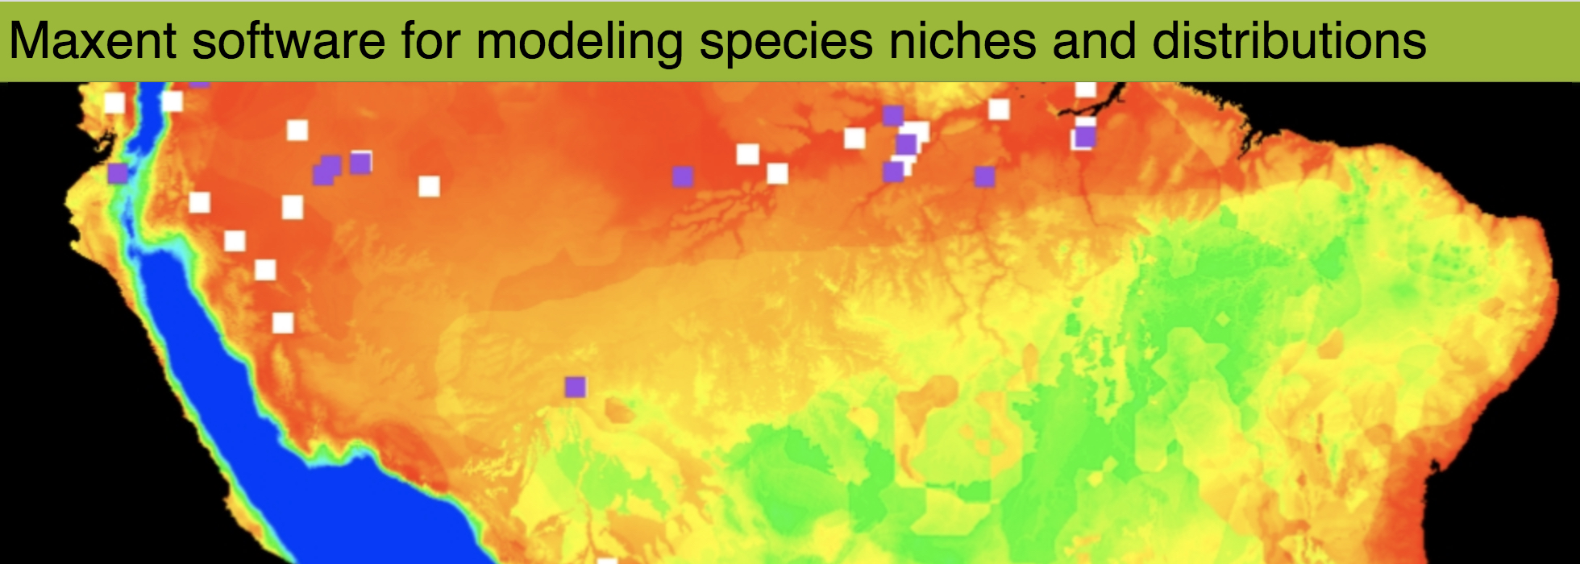
Modeling the Distribution of Species: Present
Notes:
We used specimen data from the herbaria of UF, FSU, and U of S Florida (>500,000 specimens) to map the distribution of >2700 species. We then used software for ecological niche modeling of each species based on environmental features, such as temperature, precipitation, soil type, etc.

Slide 11
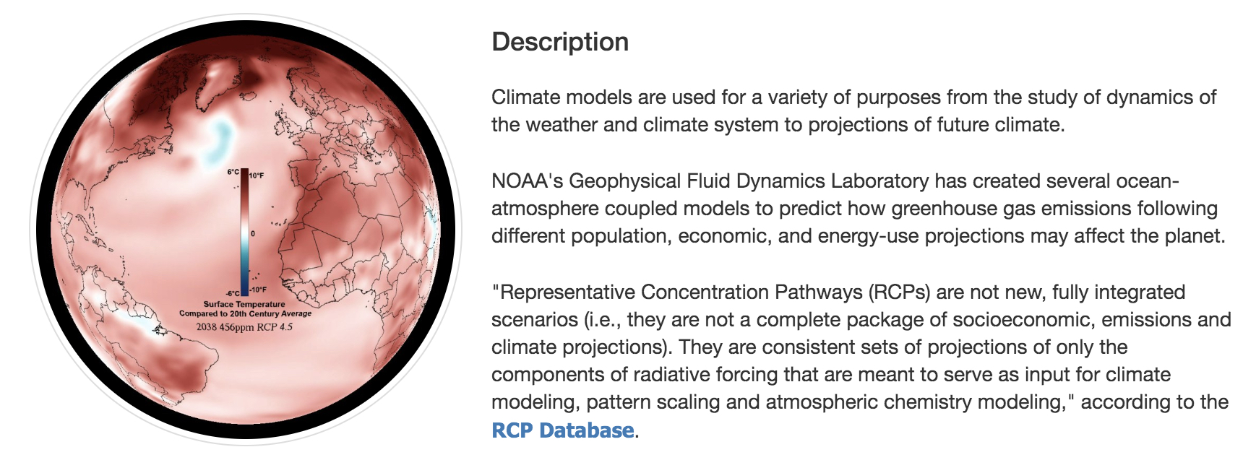
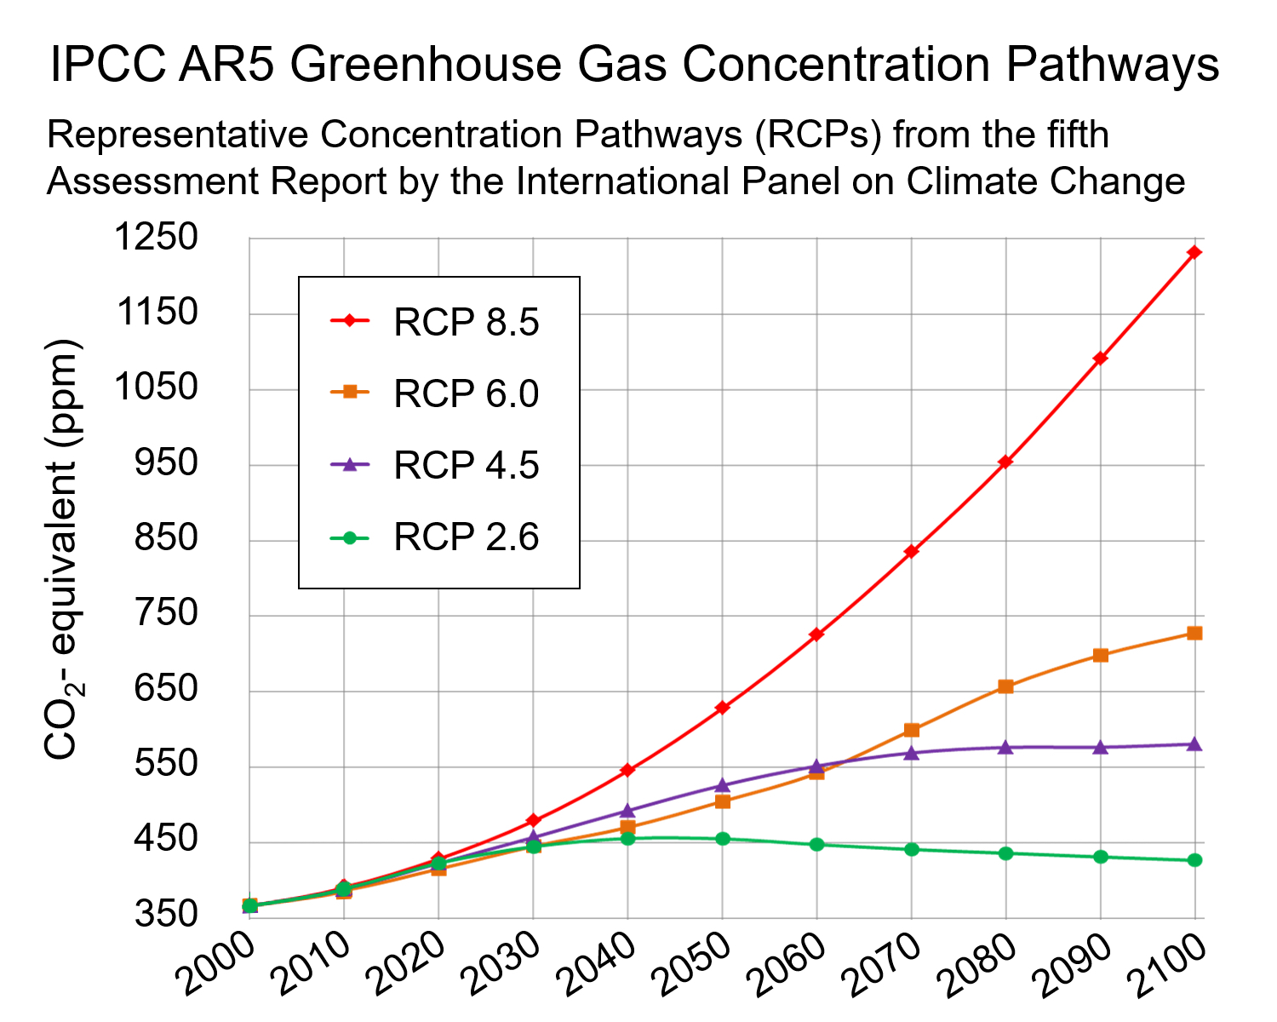

Modeling the Distribution of Species: Future
Representative Concentration Pathways: Models for Future Temperatures
Continues to rise – 3.7 C
Peak in 2060 – 2.2 C
Peak in 2040 – 1.8 C
Peak in 2020 – 1 C
Notes:
We used specimen data from the herbaria of UF, FSU, and U of S Florida (>500,000 specimens) to map the distribution of >2700 species. We then used software for ecological niche modeling of each species based on environmental features, such as temperature, precipitation, soil type, etc.

Slide 12
Modeling the Distribution of Species: Future
Representative Concentration Pathways: Models for Future Temperatures
Continues to rise – 3.7 C
Peak in 2060 – 2.2 C
Peak in 2040 – 1.8 C
Peak in 2020 – 1 C
Notes:
We used specimen data from the herbaria of UF, FSU, and U of S Florida (>500,000 specimens) to map the distribution of >2700 species. We then used software for ecological niche modeling of each species based on environmental features, such as temperature, precipitation, soil type, etc.

Slide 13
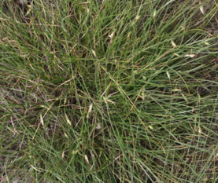
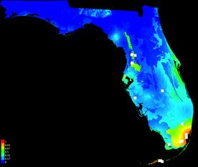
Response to Climate Change: Models for Present & Future
Abildgaardia ovata (flatspike sedge)
now

Slide 14
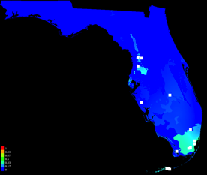
Response to Climate Change: Models for Present & Future
Abildgaardia ovata (flatspike sedge)
now
2050

Slide 15
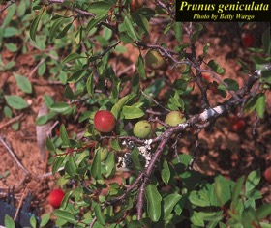
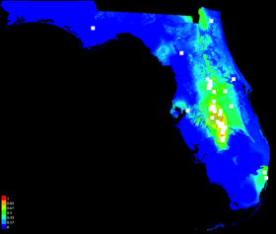
Response to Climate Change: Models for Present & Future
Abildgaardia ovata (flatspike sedge)
now
2050
Prunus geniculata (scrub plum)
now

Slide 16
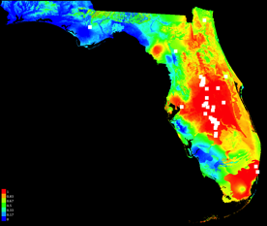
Response to Climate Change: Models for Present & Future
Abildgaardia ovata (flatspike sedge)
now
2050
Prunus geniculata (scrub plum)
now
2050

Slide 17
Florida Plant Diversity: Now & 2050
Present
High
species diversity
Low
species diversity

Slide 18
Florida Plant Diversity: Now & 2050
Present
2050
High
species diversity
Gain of
species diversity
Low
species diversity
Loss of
species diversity
# spp 2050 - #spp now

Slide 19
Past Distribution: Scrub Mint Clade (Naranjo 2020)

Slide 20

Past Distribution
PaleoClim:
paleoclim.org
Naranjo 2020

Slide 21
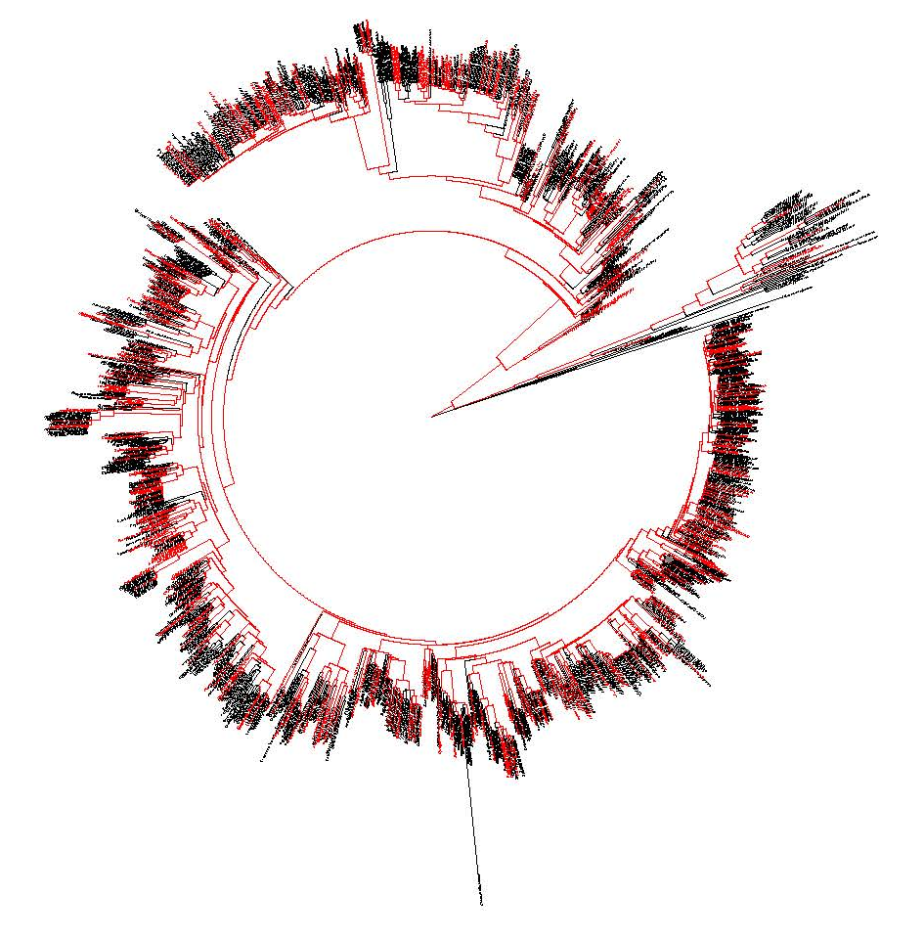
Computing Phylogenetic Diversity
Phylogenetic Diversity:
How much of the Tree of Life is present in a geographic area?
Species A
Species B
Species C
Species D
Species E
…

Slide 22


Niche Evolution in Allopolyploids
Niche Intermediacy
Niche Expansion
Blaine
Marchant
Species A
2n
Species A
2n
Species C
4n
Species C
4n
Species B
2n
Species B
2n
Niche Contraction
Niche Novelty
Species A
2n
Species A
2n
Species C
4n
Species C
4n
Species B
2n
Species B
2n
Marchant et al. 2016

Slide 23
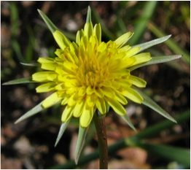
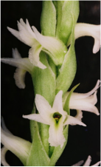
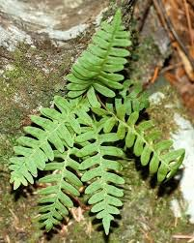
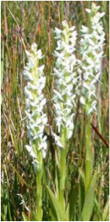
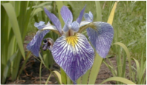
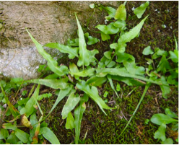
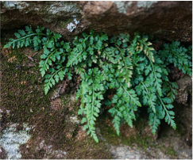
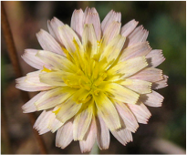
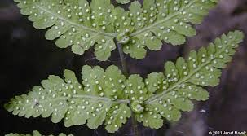

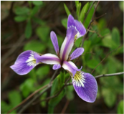
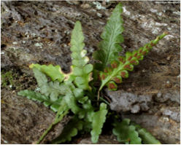
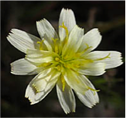
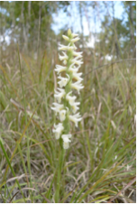
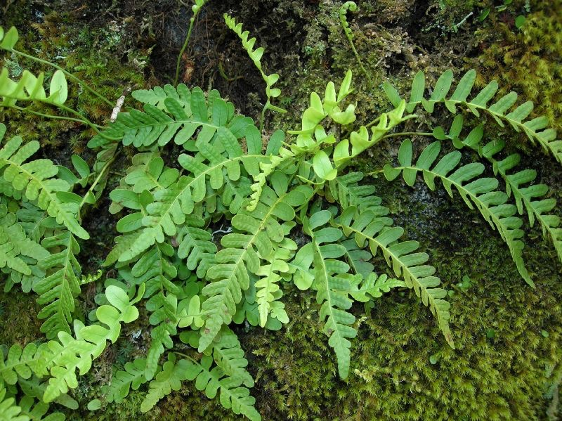
+
Polyploidy
Asplenium rhizophyllum
(2n)
Asplenium montanum
(2n)
Asplenium pinnatifidum
(4n)

Slide 24
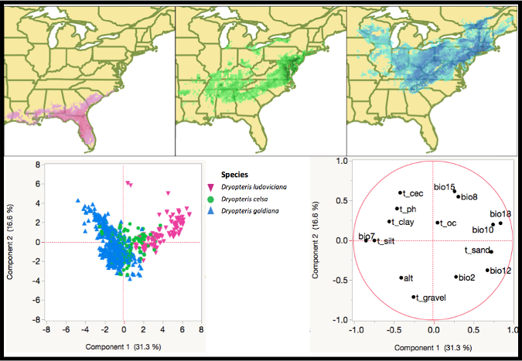
Niche Evolution in Allopolyploids
Niche Intermediacy
Breadth: Parent < Polyploid < Parent
Overlap: Polyploid > 0.3
Blaine
Marchant
Dryopteris celsa
Nickrent, D.L. et al. 2006 onwards. PhytoImages.
http://www.phytoimages.siu.edu
Marchant et al. 2016

Slide 25
Niche Evolution in Allopolyploids
13 allopolyploids & parents
Niche intermediacy: 8
Niche contraction: 2
Niche expansion: 2
Niche novelty: 1
More cases are needed!
Blaine
Marchant
+
Polyploidy
Asplenium rhizophyllum
(2n)
Marchant et al. 2016

Slide 26
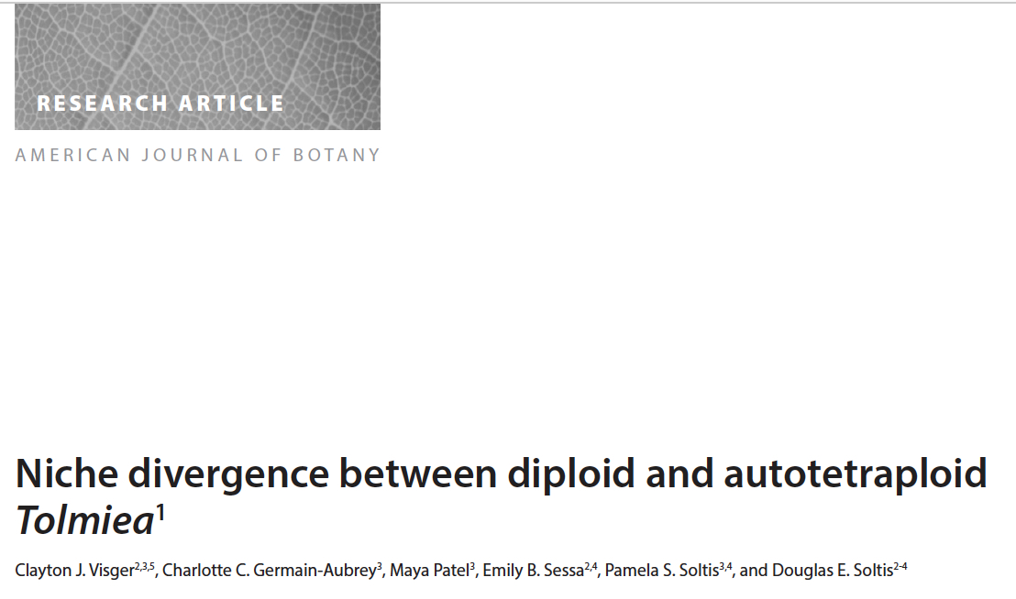
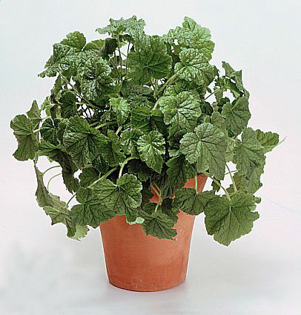
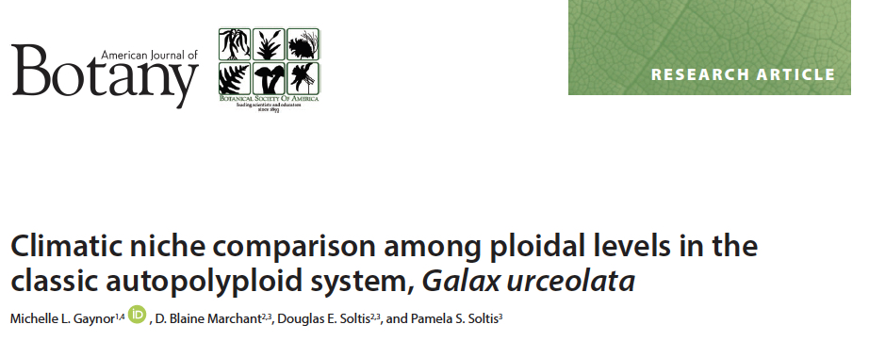
Niche Evolution in Autopolyploids
Tolmiea menziesii
Galax urceolata

